Slide 1
Using DDLite to extract pizza types
Suhan Liu
and Stan Thornhill

Slide 2
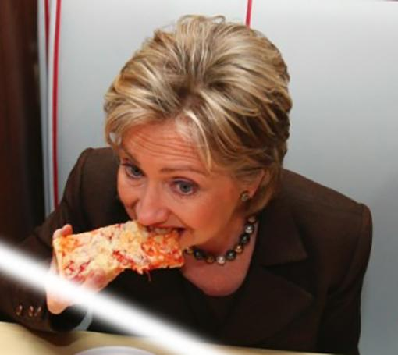
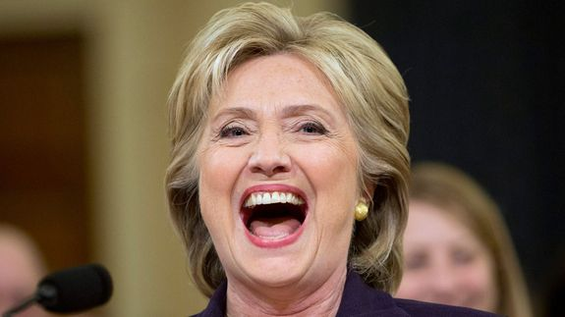
Motivations
Allow yelp to automatically generate menu for those restaurants who do not post their menus on Yelp
Help pizzerias to know what kinds of pizzas people like

Slide 3

To connect people with great local businesses.
Website, mobile app
Help users find local businesses
Dentists, hairstylists, mechanics, etc.
Allows users to rate and review businesses
>102 million local reviews
Most popular: restaurants

Slide 4
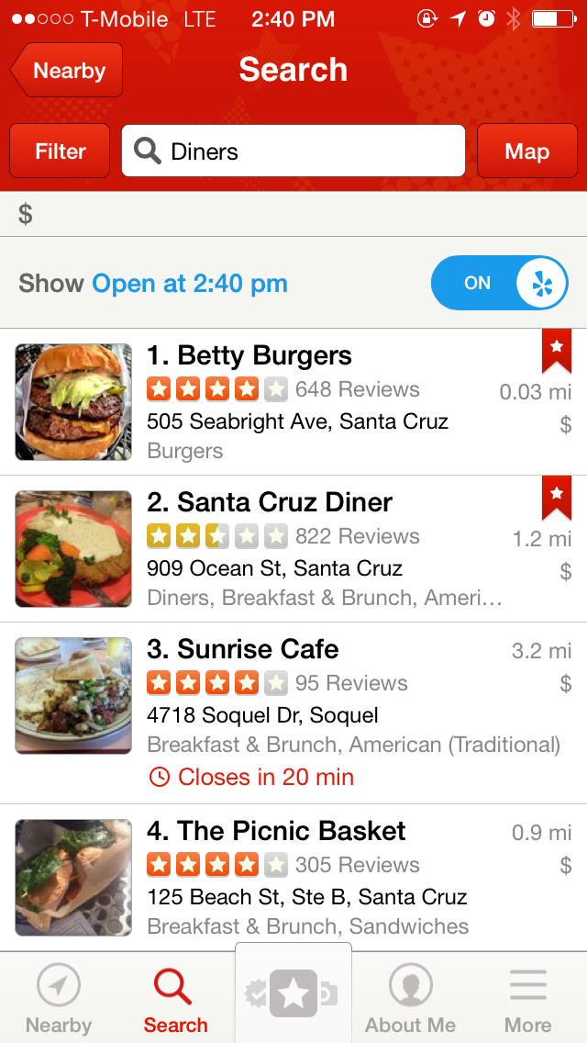
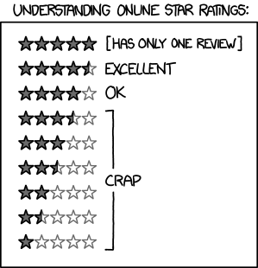

Restaurant Reviews &
Star Ratings

Slide 5
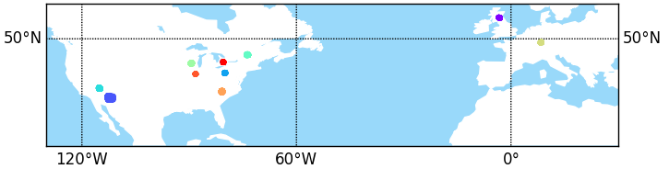
Data - Yelp Dataset Challenge
Business information and user reviews
Our project - focus on restaurants only

Slide 6
Data - Yelp Dataset Challenge
Business information and user reviews
Our project - focus on restaurants only
Montreal
Edinburgh
Las Vegas
Waterloo, IA
Pittsburgh, PA
Karlsruhe
Charlotte, NC
Phoenix
Champaign, IL
Madison, AL

Slide 7
Original Data
# businesses | 61184
# restaurants | 21892
max # reviews | 4578 (per restaurant)
min # reviews | 3 (per restaurant)
avg # reviews | 49.50 (per restaurant)

Slide 8
Extracted Data
# restaurants | 2223
max # reviews | 50 (per restaurant)
# of reviews | 44806 reviews

Slide 9
Getting Pizza Ontology
From Stanford website
Giving us a general idea about types of pizzas
We tried software called protege on the two laptops but failed extract the ontology

Slide 10
Using DDLite
From the presentation about DeepDive, we noticed that there is a light ver. called DDLite
Lack of documentation
Hack the examples in DDLite to learn it

Slide 11
DeepDive Lite (ddlite)
DDLite is a lightweight powerful framework for prototyping & developing structured information extraction applications for domains in which large labeled training sets are not available or easy to obtain, using the data programming paradigm.
In the data programming approach to developing a machine learning system, the developer focuses on writing a set of labeling functions, which create a large but noisy training set.

Slide 12
DeepDive Lite (ddlite)
DDLite learns a generative model of this noise- learning, essentially, which labeling functions are more accurate than others- and uses this to train a discriminative classifier.
Developers can focus on writing labeling functions- which are just (Python) functions that provide a label for some subset of data points.
DDLite is a work in progress, but some people have already begun developing applications with it, and initial feedback has been positive.

Slide 13

Extracting Reviews from JSON File
Using iPython
Process is reaaaaaaaally
s-----l------o------w

Slide 14
Difficulties of Extraction
Restaurant candidates:
Restricted to Categories including both “Pizza” and “Restaurants”
Reviews in one file - Too BIG:
Separate reviews into different files, restricted to 50 reviews per restaurant

Slide 15
Extracting Candidates
At first, we tried to use some keywords like “pepperoni” and “sausage” to create candidates.
Then we tried to restrict the candidate to only 4 words ending with “pizza”
Additional rule: beginning with some words which are usually used as type of pizza

Slide 16
Screenshot Page for Python code
Show code

Slide 17
DocParser
Look into each individual files under the given folder
Get the whole text as a string corresponding to the file name
Problem (for Mac users): .DS_Store

Slide 18
Sentence Parser
Parse all sentences word by word and generate their lemmas, poses, dep_parents, sent_id, doc_id, etc.
Example: Poses (Stanford paper)

Slide 19
Dependency Tree
Screenshot
explain relationship

Slide 20
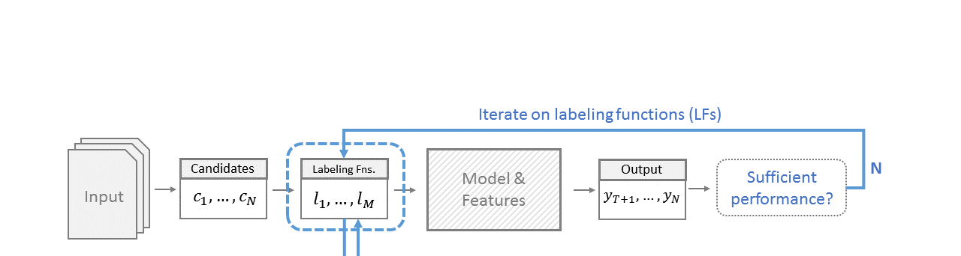
DDLiteModel
Generate features using DDLiteModel
This let us iterate with our model to develope labeling functions

Slide 21
Generating Ground Truth Set
Need one entry per candidate
Value of 1 for positive result, -1 for negative result, 0 if it isn’t in the ground truth label set
Assign half of holdout to a validation set, another half to a test set

Slide 22
MindTagger
Generating candidate sentences including the candidates
Highlight candidates
User is able to interact with the system to make choices
User can select ✔ for positive assignment

Slide 23
Labeling Functions
Positive: Like, love, usually, favorite, good, great, don’t like, bad…
Negative: Prepositions, Verbs, other food, etc.
Examples

Slide 24
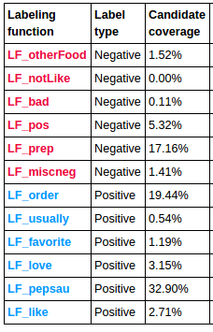
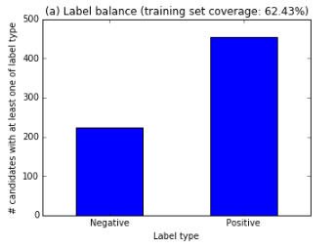
Labeling Stats and Graphs - Part I

Slide 25
Learning and Making Predictions
Using the function called “learn_weights”
Learn an elastic net logistic regression model
SGD or MiniBatch can be performed
alpha=0.5 (elastic net mixing parameter (0 for l2, 1 for l1) ), mu
Using function called “plot_calibration”

Slide 26
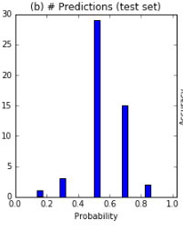
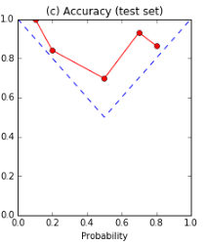

Labeling Stats and Calibration Plot - Part II

Slide 27
Constraints for our Knowledge Base
Cannot use pizza ontology - Missing some features like Italian Pizza must be thin crust
Names of pizza types sometimes are really rare to see in other places, so it’s sometimes difficult for us to find that name.

Slide 28
Pros & Cons for DDLite
Pros:
Using Python
Light version
Easy to get started
Cons:
Lack of documentations
Missing some functions in new version, lack of consistent functionality
Different versions may need different ways to program

Slide 29
Future Work
Try to using Pizza ontology to get more pizza types
More work on labeling functions to increase coverage and reducing the conflicts
Find a way to reduce the uncertainty for the learning process
Using fine-grained entity recognition

